Slide 1
Shortest Path Problem
（最短路径问题）

Slide 2
Many problems in the real life are related to the shortest path problem. Such as
  Pipe lines
  Electric power grid
  Airline system
  Communicating network
School of Computer Science, BUPT

Slide 3
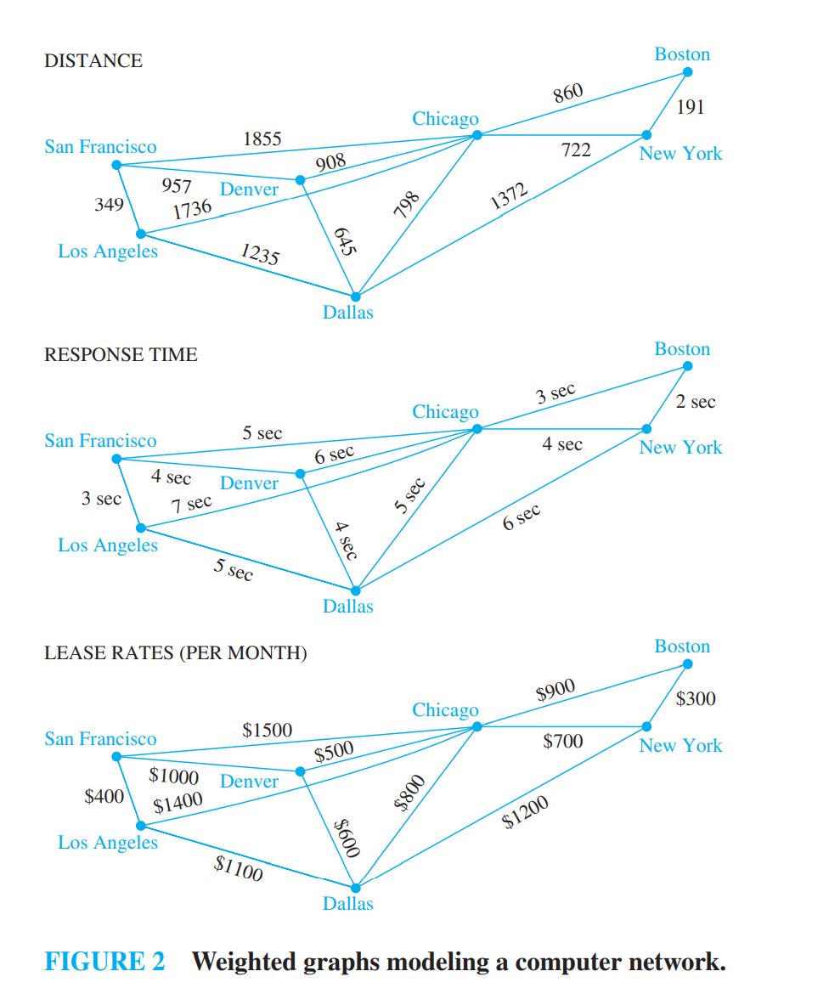
example
School of Computer Science, BUPT

Slide 4
Problem
There are two types of such problems
  Determining the shortest path from a vertex to an assigned vertex.
  Determining the shortest path of any two vertices in the graph.
School of Computer Science, BUPT

Slide 5
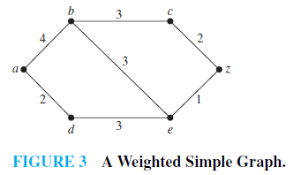
Example1
What is the length of a shortest path between a and z in the weighted graph shown in Figure 3?
School of Computer Science, BUPT

Slide 6
Dijkstra Algorithm
The algorithm is to find the shortest way from v₁ to v_{n},at the same time,it gets the shortest way from v₁ to each other vertices in the graph.
School of Computer Science, BUPT

Slide 7
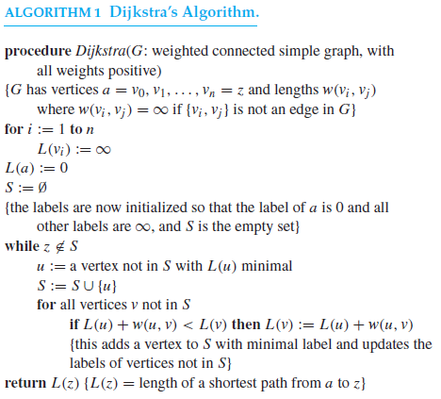
School of Computer Science, BUPT

Slide 8
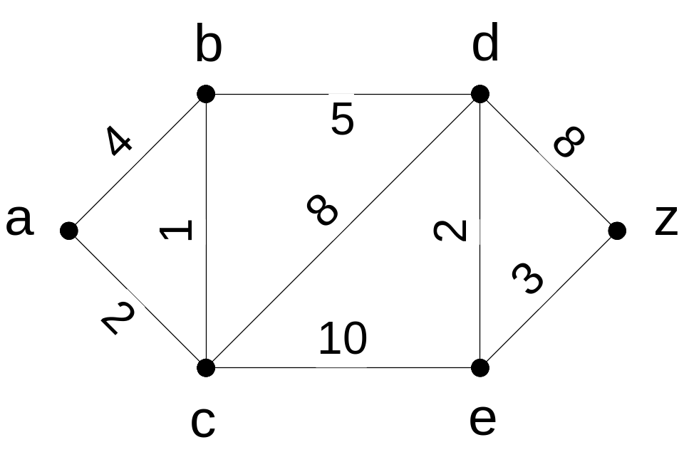
Dijkstra’s Algorithm Example 2

Slide 9
Dijkstra’s Algorithm Example 2
∞
4 (a)
∞
3 (a, c)
8 (a, c, b)
10 (a, c)
∞
16 (a, c, b, d)
0
13 (a, c, b, d, e)
∞
∞
10 (a, c, b, d)
2 (a)
12 (a, c)

Slide 10
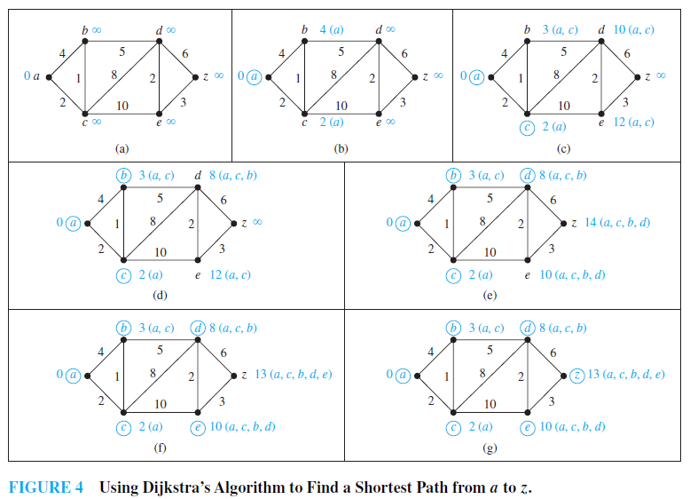
School of Computer Science, BUPT

Slide 11
Theorem 1
Dijkstra’s algorithm produces the length of a shortest path between two vertices a and z in an undirected connected weighted graph
  inductive hypothesis the following assertion:At the kth iteration
  (i ) ∀u∈ S ,L_{k}(u) is the length of a shortest path from a to u, and
  (ii ) ∀u∉ S, L_{k}(u) is the length of a shortest path from a to u contains only (besides the vertex itself) vertices in S
School of Computer Science, BUPT

Slide 12
When k = 0, S = ∅, so the length of a shortest path from a to a vertex other than a is ∞. Hence, the basis case is true.
Assume that the inductive hypothesis holds for the kth iteration.
Let v ∈ S at the (k + 1)st iteration,
  From the inductive hypothesis the vertices in S before the (k + 1)st iteration are labeled with the length of a shortest path from a.
  Also, v must be labeled with the length of a shortest path to it from a.
    If this were not the case, at the end of the kth iteration there would be a path of length less than L_{k}(v) containing a vertex not in S.
    Let u be the first vertex not in S in such a path.
    There is a path with length less than L_{k}(v) from a to u containing only vertices of S.
    This contradicts the choice of v.
School of Computer Science, BUPT

Slide 13
Let u ∉ S after k + 1 iterations.
  A shortest path from a to u containing only elements of S either contains v or it does not.
    If it does not contain v, then by the inductive hypothesis its length is L_{k}(u).
    If it does contain v, then L(u) =L_{k}(v) + w(v, u). This shows that (ii) is true, because L_{k+1}(u) = min{L_{k}(u), L_{k}(v) + w(v, u)}.
School of Computer Science, BUPT

Slide 14
THEOREM 2
Dijkstra’s algorithm uses O(n²) operations (additions and comparisons) to find the length of a shortest path between two vertices in a connected simple undirected weighted graph with n vertices.

Slide 15
Finding the shortest path between any two vertices
Distance Matrix: Let G is a graph with n vertices. The distance matrix of G is D=(d_{ij})_{n×n}
  d_{ij} represent the the weights of the edge (v_{i},v_{j})
  If there’s no edge between v_{i} and v_{j} then d_{ij}=∝
  Let D²=D*D= (d_{ij}²)_{n×n}
  d_{ij}²=min{d_{i1}+d_{1j}, d_{i2}+d_{2j},…, d_{in}+d_{nj},}
    d_{ij}² is the shortest length of the path from v_{i} to v_{j} with two edges.
  As the same D^{k}=D^{k-1}*D= (d_{ij}^{k})_{n×n}
    d_{ij}^{k} is the shortest length of the path from v_{i} to v_{j} with k edges.
School of Computer Science, BUPT

Slide 16
Define ⊕
Let A= (a_{ij})_{n×n} , B= (b_{ij})_{n×n}
C=A ⊕ B = (c_{ij})_{n×n}
  c_{ij}=min(a_{ij}, b_{ij})
P=D ⊕ D² ⊕ D³ ⊕ … ⊕ D^{n}
  p_{ij} = (p_{ij})_{n×n}
  p_{ij} represent the shortest length from v_{i} to v_{j}
School of Computer Science, BUPT

Slide 17
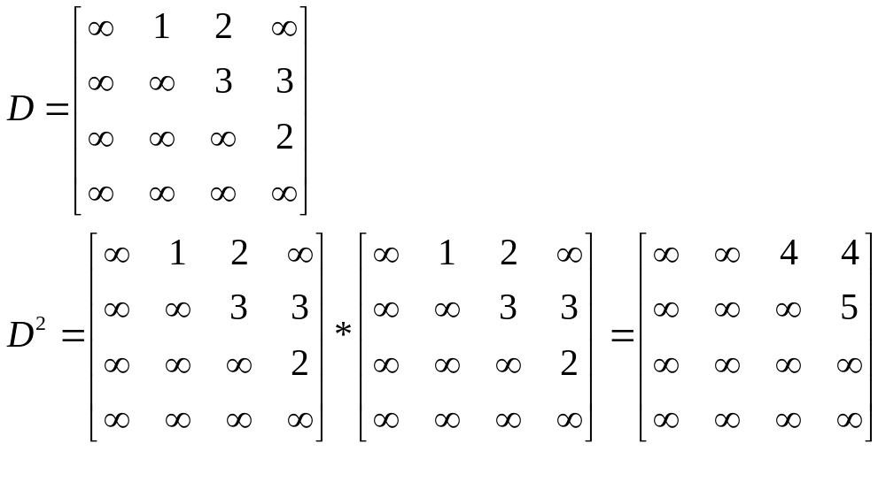
Example
1
3
3
2
2
School of Computer Science, BUPT

Slide 18
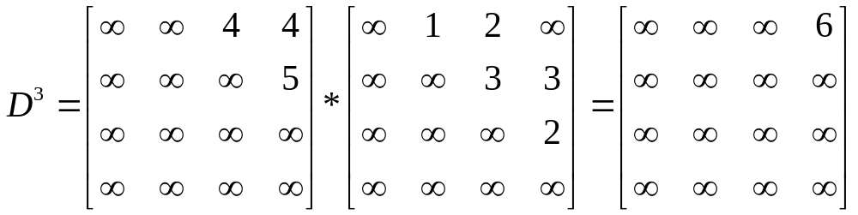
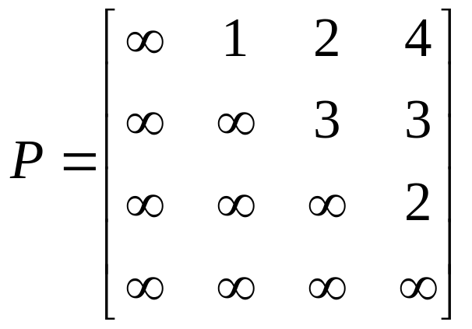
D₄=(∝) _{4×4}
P=D ⊕ D² ⊕ D³ ⊕D⁴
School of Computer Science, BUPT

Slide 19
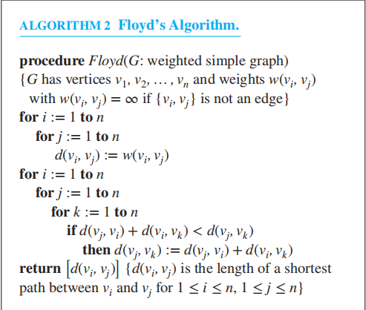
Floyd’s algorithm

Slide 20
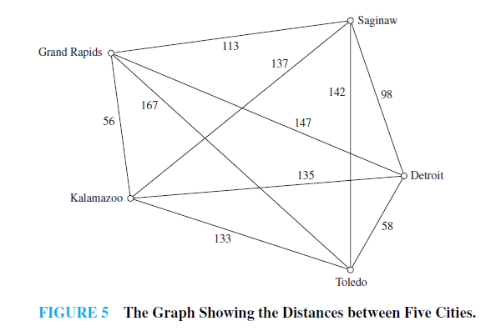
The traveling salesman problem
School of Computer Science, BUPT

Slide 21
homework
§10.6
  5（in exercise 2），21，
  Optional 16, 18, 26
School of Computer Science, BUPT

